Slide 1

Unity Game Engine
Ante Zovko

Slide 2





Introduction to unity
How to download
History
How to use
Competitors
General Review

Slide 3
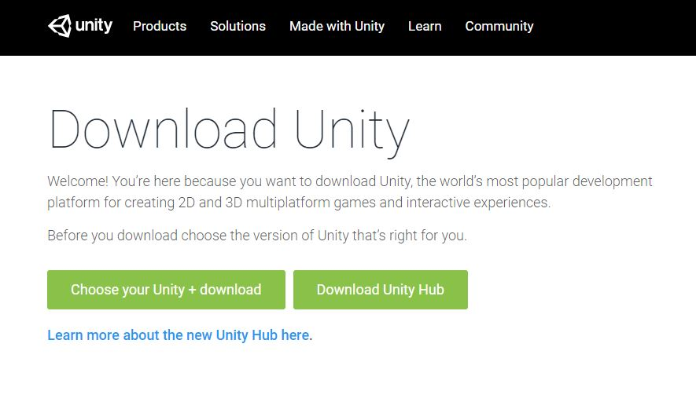
How To download
Google: “Unity Download”
Choose between a specific version or Unity hub
Unity Hub highly recommended

Slide 4
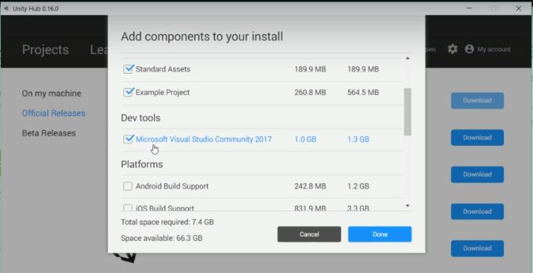
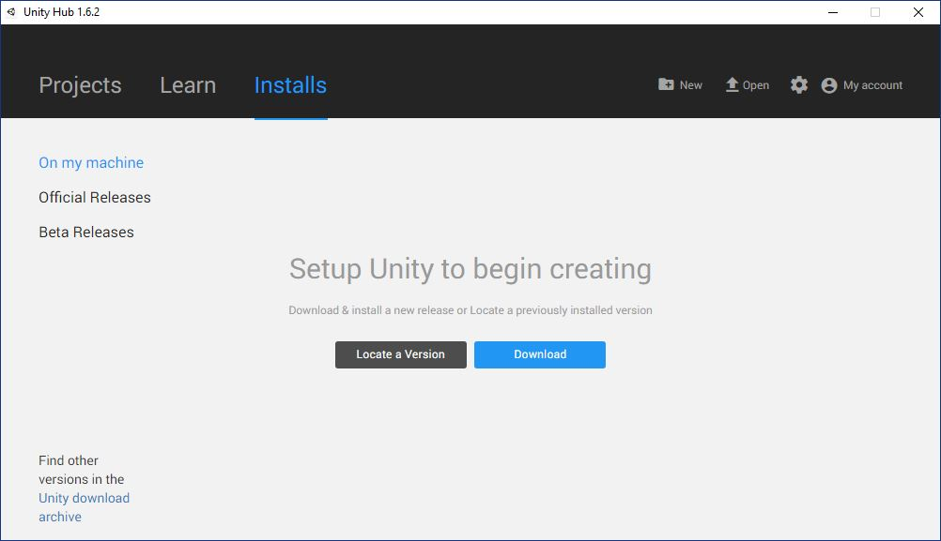
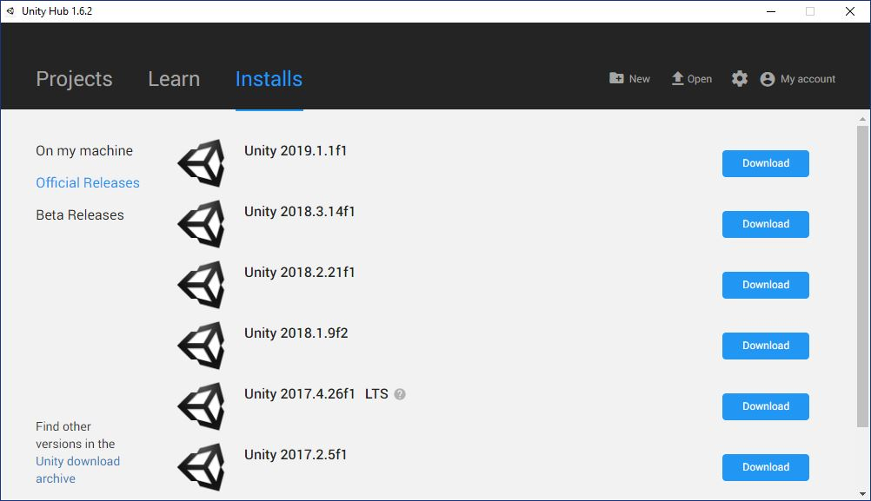
How to download

Slide 5
Introduction to unity
How to download
History
How to use
Competitors
General Review

Slide 6
History
What is unity?
Unity is a cross-platform real-time engine developed by Unity Technologies.
It can be used to create both 3D and 2D games.
It was launched in 2005
As of 2018, Unity includes a fully-supported, modern .NET runtime
Programming Language(s)
First language supported was “Boo”
Boo was dropped in Unity 5 due to a small userbase
A version of JavaScript called “UnityScript” was used until 2017
In 2017, Unity removed support for all other languages in favor of C#

Slide 7
Availability
The Unity Editor is available on Windows, Mac OS, and Linux
The latest version is 2019.1.1
Supported Platforms
The engine supports games for 29 different platforms
Windows, Mac OS, Android, iOS, PlayStation 4, Xbox One, Wii U…
Since version 5, Unity offers the WebGL Bundle compiled to JavaScript

Slide 8
Introduction to unity
How to download
History
How to use
Competitors
General Review

Slide 9
How to use
New Project
Simple GUI for a game
Scripts
Final product

Slide 10
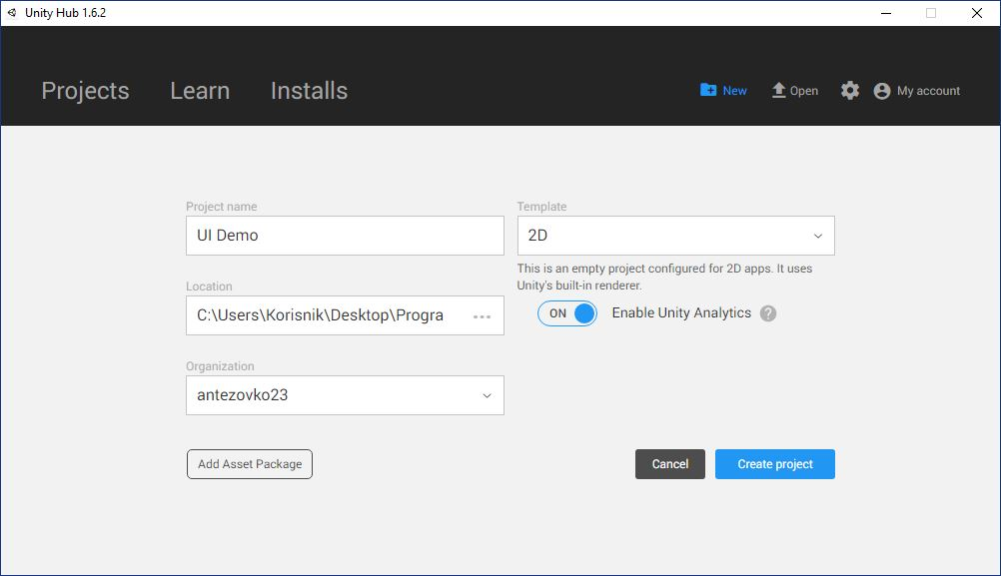
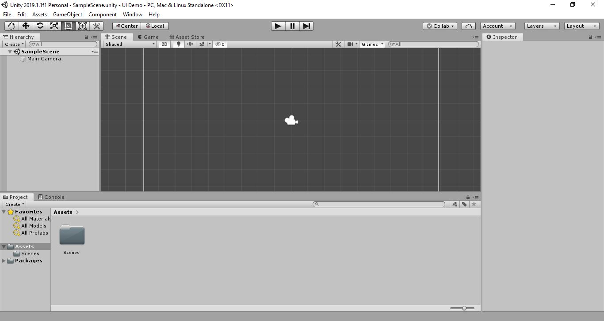
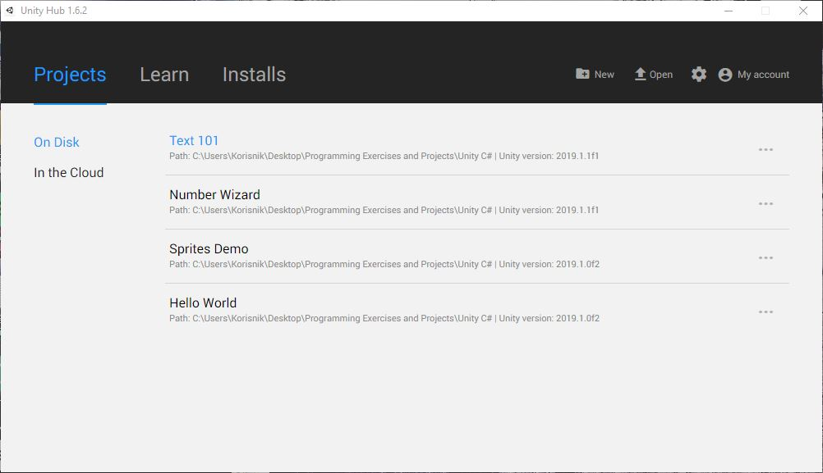
How to use
Creating a New Project

Slide 11
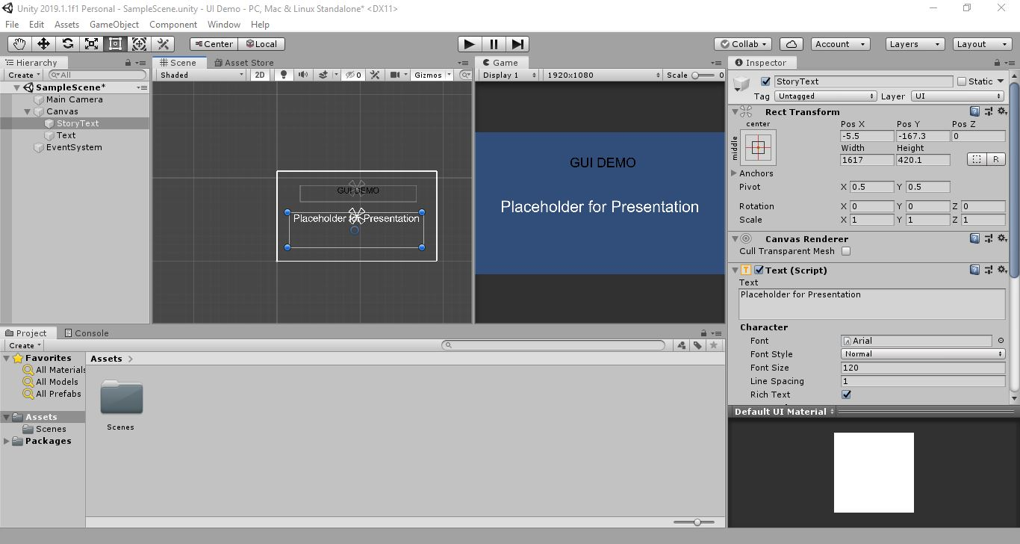
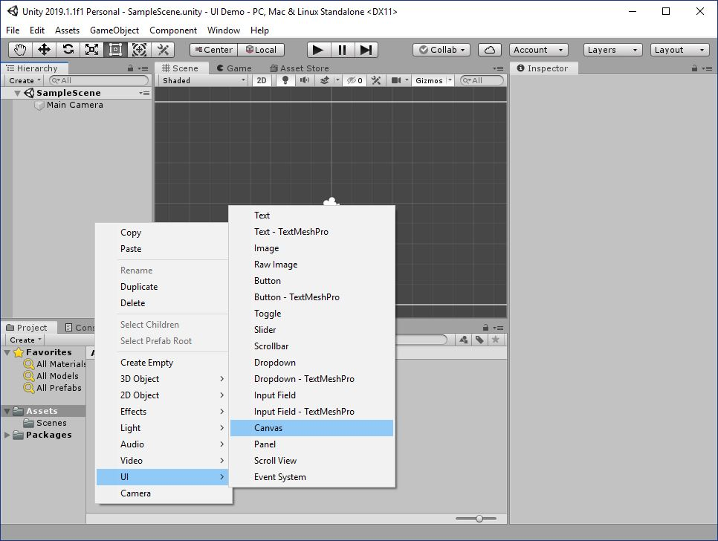
How to use
Simple GUI For a game

Slide 12
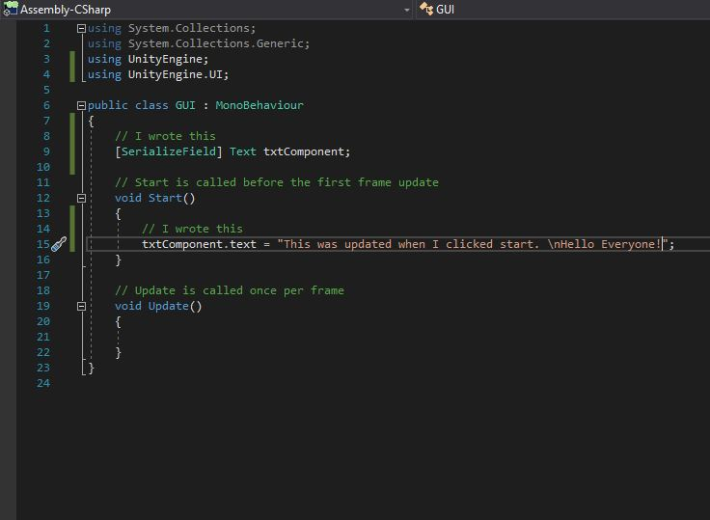
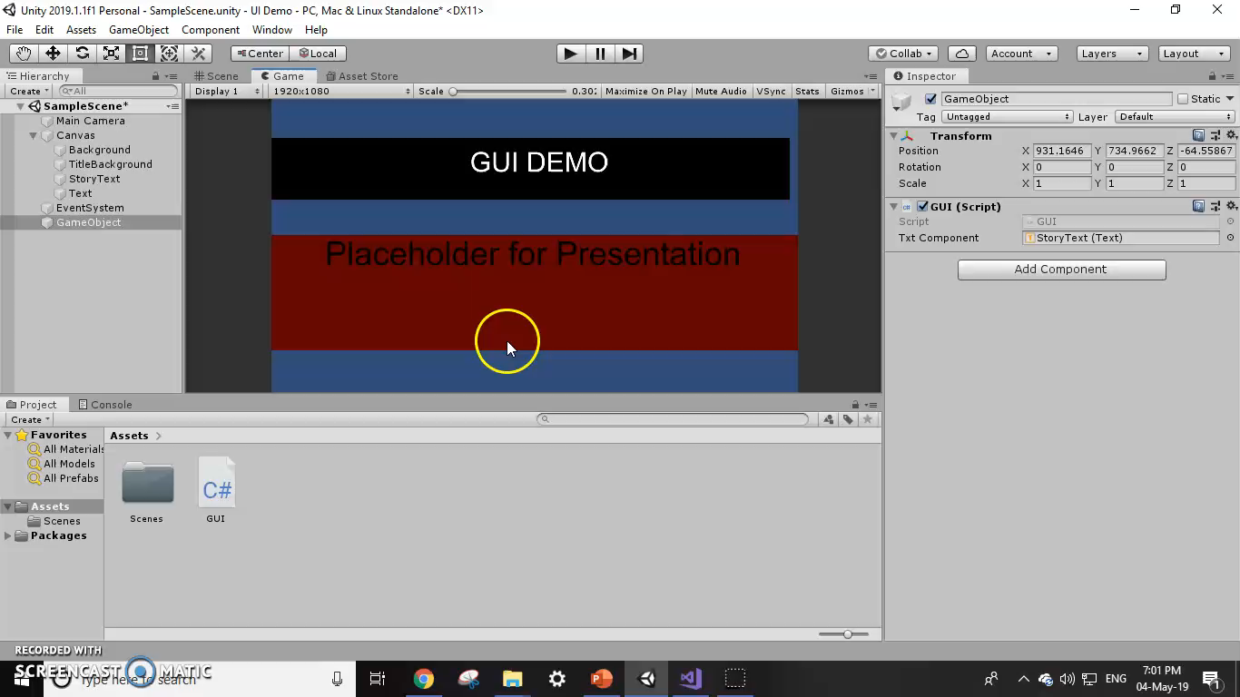
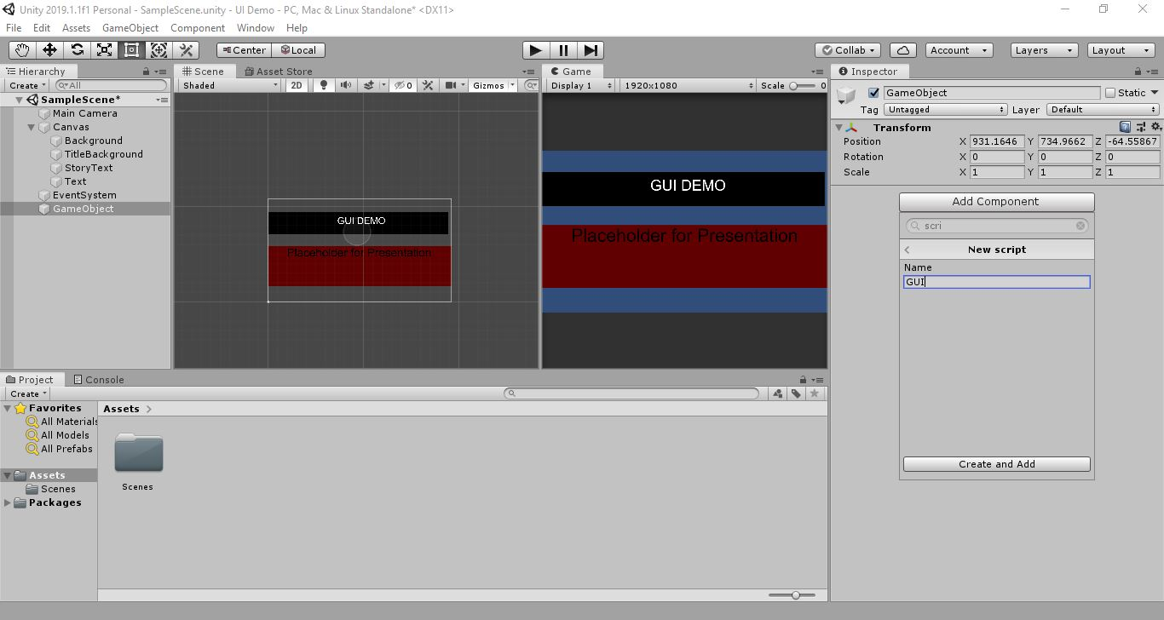
How to use
Scripts

Slide 13
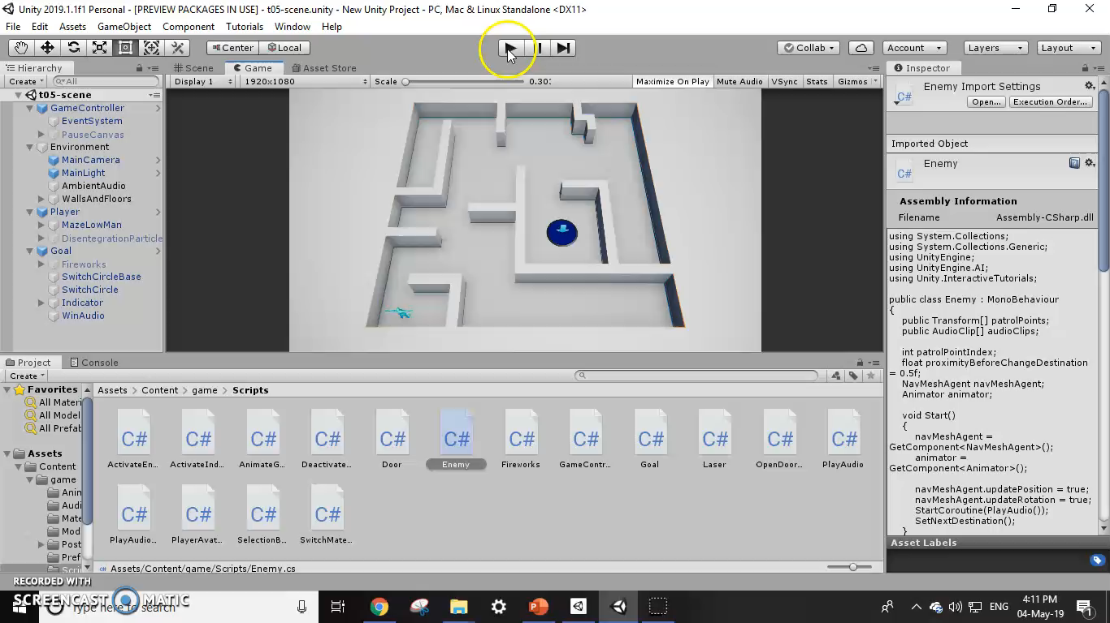
how to use
Final Product

Slide 14
Introduction to unity
How to download
History
How to use
Competitors
General Review

Slide 15
Competitors
Unreal Engine, Godot Engine, CryEngine, Marmalade SDK.
Market
Unreal Engine is used for PC games while Unity is used for Mobile Games
34% of the top 1,000 free mobile games are made with Unity
It is also at the forefront of the growing VR market
Notable Games: Pokémon GO, Super Mario Run, Angry Birds 2, Wasteland 2

Slide 16
Pricing
Personal for Beginners
Free
Available if revenue or funding does not exceed $100K per year
No additional services and training
Plus for Hobbyists
$35 per month
Available if revenue or funding does not exceed $200K per year
Monthly expert live sessions, real-time user feedback, customer success advisor
Pro for teams and freelancers
$125 per month
No limit on revenue or funding
$800+ in benefits including support, features for team efficiency and game performance

Slide 17
Introduction to unity
How to download
History
How to use
Competitors
General Review

Slide 18
General review
Benefits
Easy to use
Community size
Royalty free licensing model
Unmatched platform support
Drawbacks
Closed source without extremely expensive source code license.
Many useful features sit behind a $1500 paywall.
Expensive licenses for high quality graphics
Physics Simulations not as good as in other engines

Slide 19
Sources
https://instabug.com/blog/game-engines/
http://www.potenzaglobalsolutions.com/blogs/5-rarely-known-advantages-and-disadvantages-of-unity-game-development
https://instabug.com/blog/game-engines/
https://unity.com/
https://en.wikipedia.org/wiki/Unity_(game_engine)

Slide 20

Questions

